Slide 1
Structural Equation Modeling (Pizza and Pilots Presentation)
Dr. Richard Charnigo
Professor of Statistics and Biostatistics
RJCharn2@aol.com
07 December 2015

Slide 2
Motivation
Structural equation modeling is useful for data analysis entailing one or both of two features that render ordinary regression modeling inapplicable:
1. There is not a clear dichotomy of “independent variables” versus “dependent variables” because some variables both predict and are predicted by other variables in the modeling.

Slide 3
Motivation
This may happen in a longitudinal study if the value of a variable at an intermediate time point both predicts its value at a later time point and is predicted by its value at an earlier time point.
This may happen in a cross-sectional study or a longitudinal study if a variable is a “mediator”. For instance, rumination may be a mediator between stress and depression.
So, rather than using “independent variable” and “dependent variable”, we refer to variables predicted by other variables in the modeling as “endogenous” and to variables not predicted by other variables in the modeling as “exogenous”.

Slide 4
Motivation
2. What we are mainly interested in is not directly observable but is measured, imperfectly, using one or more instruments. Such instruments are often scales obtained by summations of Likert items.
In this context, that which is not directly observable is often called a “latent construct”, while a corresponding instrument is often referred to as an “observable indicator”.

Slide 5
A Hypothetical Example
Consider a longitudinal study of college students who have a history of drinking in high school. The goal of the study is to ascertain whether sensation seeking may influence drinking, whether drinking may influence sensation seeking, or both.
Let SS₁ denote sensation seeking at the beginning of college and DR₁ drinking at the beginning of college.
These are exogenous variables in that they will not be predicted by any other variables that we will include in our structural equation model. They are also latent variables because we do not observe them.

Slide 6
A Hypothetical Example
Let SS₂ denote sensation seeking after one year of college and DR₂ drinking after one year of college. Let SS₃ denote sensation seeking after two years of college and DR₃ drinking after two years of college.
These are endogenous variables in that they will be predicted by other variables that we will include in our structural equation model. They are also latent variables because we do not observe them.

Slide 7
A Hypothetical Example
Let NS₁ be the score observed on a scale of novelty seeking;
IM₁ the score observed on a scale of impulsivity;
DF₁ the score observed on a scale of drinking frequency; and
DI₁ the score observed on a scale of drinking intensity, with all of these scales administered at the beginning of college.
Thus, NS₁ and IM₁ are observable indicators of the latent construct SS₁, while DF₁ and DI₁ are observable indicators of the latent construct DR₁.

Slide 8
A Hypothetical Example
Let NS₂ be the score observed on a scale of novelty seeking;
IM₂ the score observed on a scale of impulsivity;
DF₂ the score observed on a scale of drinking frequency; and
DI₂ the score observed on a scale of drinking intensity, with all of these scales administered after one year of college.
Let NS₃ be the score observed on a scale of novelty seeking;
IM₃ the score observed on a scale of impulsivity;
DF₃ the score observed on a scale of drinking frequency; and
DI₃ the score observed on a scale of drinking intensity, with all of these scales administered after two years of college.

Slide 9
A Hypothetical Example
The next slide depicts relationships among these quantities. Those labeled with “e” or “d” symbols represent random deviations from what is predicted and may be called, for lack of a better word, “errors”.
Generally speaking, a given quantity is expressed as a linear combination of those quantities which contribute to it, not unlike what is seen in regression. Thus, for example,
SS₂ = b₀ + b₁ SS₁ + b₂ DR₁ + e₇
and
DF₃ = a₀ + a₁ DR₃ + d₅.

Slide 10
A Hypothetical Example
e₁
e₂
e₃
e₄
e₅
e₆
NS₁
IM₁
NS₂
IM₂
NS₃
IM₃
e₇
e₈
SS₁
SS₂
SS₃
DR₁
DR₂
DR₃
d₇
d₈
DF₁
DI₁
DF₂
DI₂
DF₃
DI₃
d₁
d₂
d₃
d₄
d₅
d₆

Slide 11
An Actual Example
Sometimes a structural equation model is not as complicated as indicated on the preceding page. For example, if there is only one observable indicator for each latent construct, then the observable indicator may be identified with its latent construct.
An example of this occurs in my 2009 Public Health Nutrition paper with Huddleston-Casas and Simmons. We were trying to understand whether food insecurity predicted depression, or vice versa, or both, using three waves of survey data from low-income rural mothers.
The diagram, derived from Figure 1 of the paper, appears next.

Slide 12
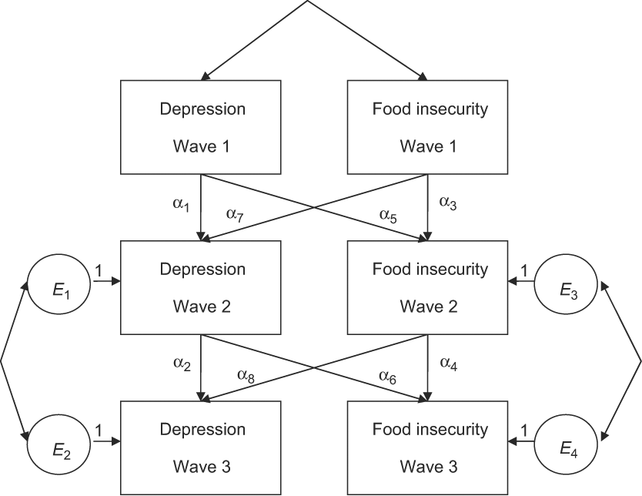
An Actual Example

Slide 13
An Actual Example
Some results, from Table 2 of the paper, are as shown below. Also, testing the null hypothesis that α₅ = α₆ = 0 yields P=0.034 in the complete case analysis (P<0.001 in the imputed analysis), and we have P=0.003 (P<0.001) in testing α₇ = α₈ = 0.

Slide 14
An Actual Example
The conclusion is that the relationship between food insecurity and depression among low-income rural mothers may be bidirectional.
And, just as linear regression models have R² and other tools to assess goodness of fit, there are various indices of fit for structural equation models. Three of them are χ² / df, RMSEA, and CFI.
In the complete case analysis from our 2009 paper, we had χ² / df = 1.835, RMSEA = 0.068, and CFI = 0.989. These are favourable values for the indices.

Slide 15
Remarks
Goodness of fit is often substantially affected by the assumptions one makes regarding which error terms are correlated. Since that is difficult to ascertain from subject matter theory, some iterative process (not unlike stepwise selection in linear regression modeling) is often helpful.
Typically we assume that quantities involved are (close to) normally distributed. However, a categorical variable can be accommodated in the sense that model parameters may be estimated for and compared across multiple groups defined by the categorical variable. We did this, too, in our 2009 paper.

Slide 16
References
Bollen and Long (1993). Testing Structural Equation Models. SAGE, Newbury Park CA.
Hoyle (1995). Structural Equation Modeling: Concepts, Issues, and Applications. SAGE, Thousand Oaks CA.
Huddleston-Casas, Charnigo, and Simmons (2009). Food insecurity and maternal depression in rural, low-income families: a longitudinal investigation. Public Health Nutrition, 12, 1133-1140.
Kline (2010). Principles and Practice of Structural Equation Modeling, 3rd Edition. Guilford, New York NY.
Mueller (1996). Basic Principles of Structural Equation Modeling. Springer-Verlag, New York NY.

